Slide 1
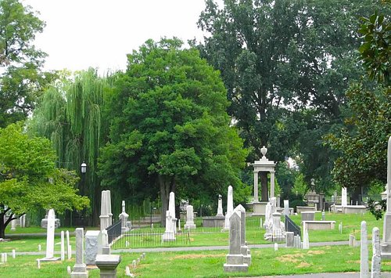


Nashville Historic Cemeteries
ADOPT A PLOT

Slide 2
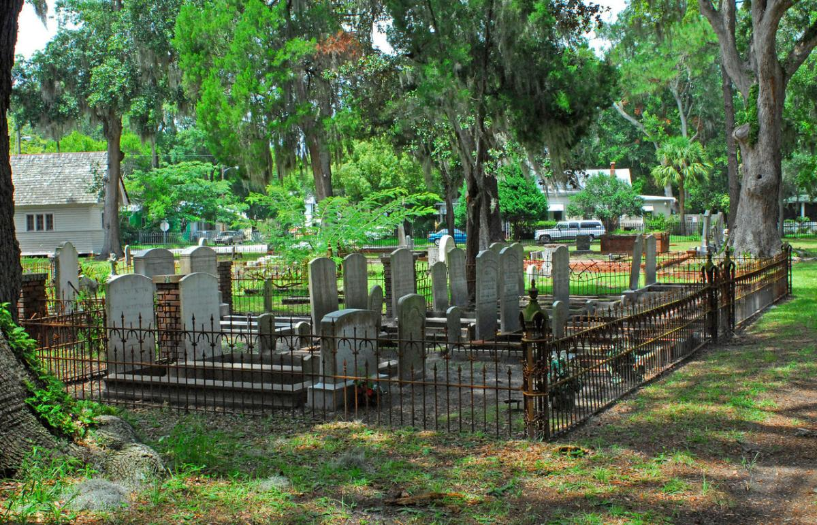
Something for Everyone
Over 19,755 Burial Plots
3,568 Unique Surnames
Discover Cause of Death
Certificate of Adoption

Slide 4
the Adopt a Plot program, where sadness finds its purpose! turn tears of sorrow into tears of joy by adopting a plot in a historic cemetery near you
November 1, Day of the Dead Festival. Dress

